Slide 1

Object Oriented Programming
CS22301
UNIT II
INHERITANCE AND INTERFACES
Bamila Virgin Louis
Asso.Prof/ CSE
SXCCE

Slide 2
Object Oriented Programming
CS22301
UNIT II
INHERITANCE AND INTERFACES
Course Objective
To know the principles of packages, inheritance and interfaces
Course Outcome
CO2: Implement the principles of packages, inheritance and interfaces

Slide 3
UNIT II
INHERITANCE AND INTERFACES
Constructors in java – Packages- Inheritance – Super classes- sub classes –Protected members – constructors in sub classes- the Object class – abstract classes and methods- final methods and classes – Interfaces – defining an interface, implementing interface, differences between classes and interfaces and extending interfaces

Slide 4
Constructors in Java

Slide 5
CONSTRUCTORS
In Java, a constructor is a special type of method used to initialize objects of a class.
It is automatically invoked when an object is created using the new keyword.
It has the same name as the class in which it resides and is syntactically similar to a method.
Constructors have no return type, not even void. This is because the implicit return type of a class’ constructor is the class type itself.
It is the constructor’s job to initialize the internal state of an object so that the code creating an instance will have a fully initialized, usable object immediately.

Slide 6
CONSTRUCTORS
Java allows objects to initialize themselves when they are created.
This automatic initialization is performed through the use of a constructor.
A constructor initializes an object immediately upon creation.
It has the same name as the class in which it resides and is syntactically similar to a method.
Once defined, the constructor is automatically called immediately after the object is created, before the new operator completes.
Constructors have no return type, not even void. This is because the implicit return type of a class’ constructor is the class type itself.
It is the constructor’s job to initialize the internal state of an object so that the code creating an instance will have a fully initialized, usable object immediately.

Slide 7
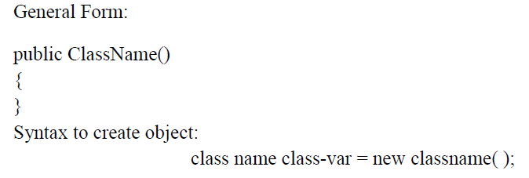
Default Constructors
A default constructor is a constructor with no parameters.
This default constructor sets all the instance fields to their default values.
So, all numeric data contained in the instance fields would be 0, all boolean values would be false, and all object variables would be set to null.

Slide 8

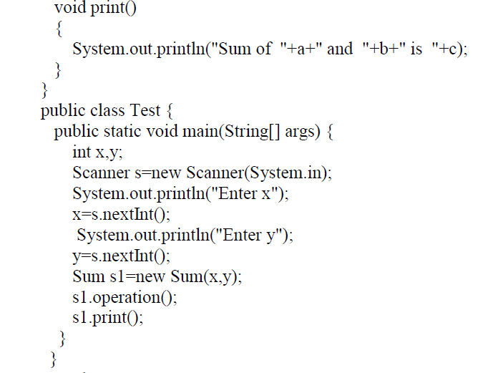
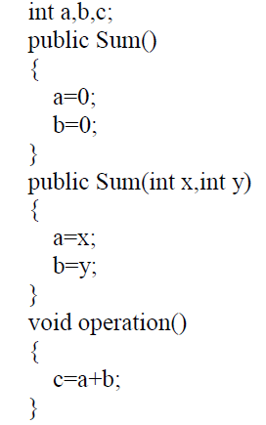
Parameterized Constructors:
A paramaterized constructor is a constructor with parameters. This parameterized constructor sets all the instance fields to specific values.

Slide 9
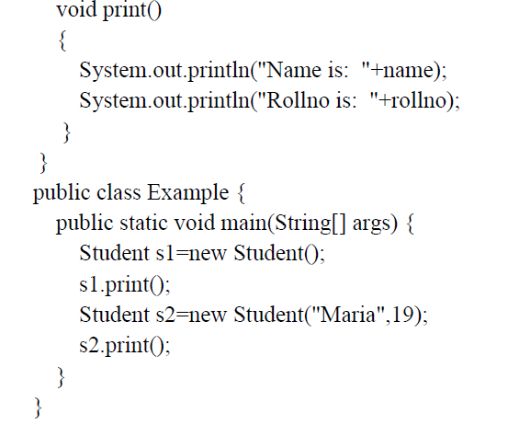
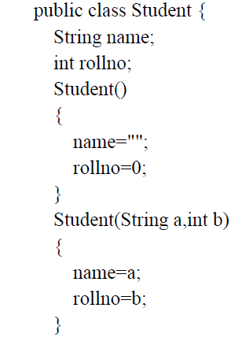
OVERLOADING CONSTRUCTORS
In addition to overloading normal methods, we can also overload constructor methods.
Example:

Slide 10
Implementing a Complex Number Class
public class Complex
{
// State (instance variables)
// Behaviour(instance methods)
// constructors
// accessors
// mutators
// operations/messages
}

Slide 11

Implementing State
An object’s state is contained in instance variables
// State
private double real;
private double imag;
Each object created from this class will have separate occurrences of the instance variables

Slide 12
Implementing Behaviour: Constructors
Constructors are methods that describe the initial state of an object created of this class.
public Complex()
{
real = 0.0; imag = 0.0;
}
public Complex(double rp)
{
real = rp; imag = 0.0;
}
public Complex(double rp, double ip)
{
real = rp; imag = ip;
}
Default Constructor

Slide 13
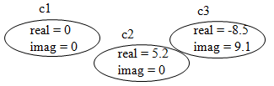
Implementing Behaviour: Constructors
Constructors are invoked only when the object is created. They cannot be called otherwise.
Complex c1, c2, c3;
c1 = new Complex();
c2 = new Complex(5.2);
c3 = new Complex(-8.5, 9.1)
Constructors initialize the state of an object upon creation.

Slide 14
USING OBJECTS AS PARAMETERS
public class complex {
int x,y;
public complex()
{
x=0;
y=0;
}
public complex(int a,int b)
{
x=a;
y=b;
}
complex add(complex c1,complex c2)
{
complex t=new complex();
t.x=c1.x+c2.x;
t.y=c1.y+c2.y;
return t;
}
void print()
{
System.out.println("a is: "+x);
System.out.println("b is: "+y);
}
}
public class Example {
public static void main(String[] args)
{
complex c1=new complex(2,2);
complex c2=new complex(3,3);
complex c3=new complex();
c3=c3.add(c1, c2);
System.out.println("c1:");
c1.print();
System.out.println("c2:");
c2.print();
System.out.println("c3:");
c3.print();
} }

Slide 15
ARGUMENT PASSING METHODS
In general, there are two ways that a computer language can pass an argument to a subroutine.
Call by value
This approach copies the value of an argument into the formal parameter of the subroutine. Therefore, changes made to the parameter of the subroutine have no effect on the argument.
Call by Reference
In this approach, a reference to an argument (not the value of the argument) is passed to the parameter. Inside the subroutine, this reference is used to access the actual argument specified in the call. This means that changes made to the parameter will affect the argument used to call the subroutine.
Java uses both approaches, depending upon what is passed.

Slide 16
public class Test {
void add(int a,int b)
{
a=a+5;
b=b+5;
}
}
public class Example {
public static void main(String[] args) {
Test t1=new Test();
int x=5,y=10;
System.out.println("Before method call");
System.out.println("x="+x);
System.out.println("y="+y);
t1.add(x,y);
System.out.println("After method call");
System.out.println("x="+x);
System.out.println("y="+y);
}
}
Output:
Before method call
x=5
y=10
After method call
x=5
y=10

Slide 17
public class Test {
int a,b;
Test(int x,int y)
{
a=x;
b=y;
}
void add(Test t)
{
t.a=t.a+5;
t.b=t.b+5;
}
}
public class Example {
public static void main(String[] args) {
Test t1=new Test(2,3);
System.out.println("Before method call");
System.out.println("a="+t1.a);
System.out.println("b="+t1.b);
t1.add(t1);
System.out.println("After method call");
System.out.println("a="+t1.a);
System.out.println("b="+t1.b);
}
}

Slide 18
Output:
Before method call
a=2
b=3
After method call
a=7
b=8

Slide 19
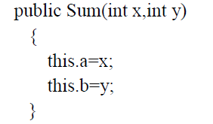
The this Keyword
Sometimes a method will need to refer to the object that invoked it. To allow this, Java defines the this keyword.
this can be used inside any method to refer to the current object.
That is, this is always a reference to the object on which the method was invoked.

Slide 20
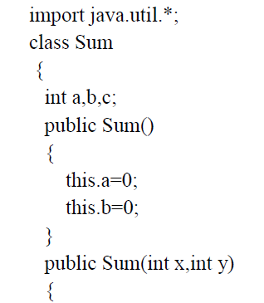
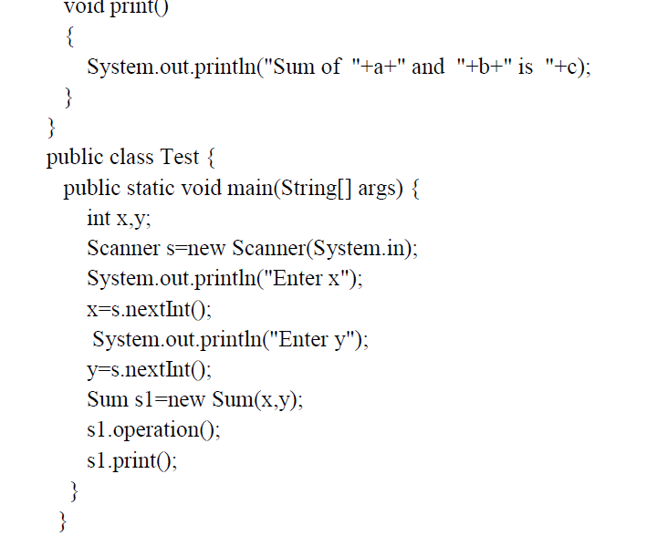
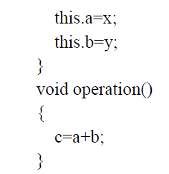
The this Keyword

Slide 21
Garbage Collection
In Java, objects are dynamically allocated by using the new operator.
In some languages, such as C++, dynamically allocated objects must be manually released by use of a delete operator.
Java handles de-allocation automatically called garbage collection.
When no references to an object exist, that object is assumed to be no longer needed, and the memory occupied by the object can be reclaimed.
Garbage collection only occurs periodically (if at all) during the execution of your program.

Slide 22
The finalize( ) Method
Sometimes an object will need to perform some action when it is destroyed.
For example, if an object is holding some non-Java resource such as a file handle, then you might want to make sure these resources are freed before an object is destroyed.
To handle such situations, Java provides a mechanism called finalization.

Slide 23
The finalize( ) Method
To add a finalizer to a class, you simply define the finalize( ) method.
The Java run time calls that method whenever it is about to recycle an object of that class.
Inside the finalize( ) method, you will specify those actions that must be performed before an object is destroyed.
The garbage collector runs periodically, checking for objects that are no longer referenced by any running state or indirectly through other referenced objects.
Right before an asset is freed, the Java run time calls the finalize( ) method on the object.

Slide 24
The finalize( ) Method
The finalize( ) method has this general form:
protected void finalize( )
{
// finalization code here
}

Slide 25
JAVA Packages

Slide 26
PACKAGES
Group of classes in a collection - package.
The package can then be further subdivided into subpackages.
Packages are convenient
for organizing our work
for separating our work from code libraries provided by others.
The standard Java library is distributed over a number of packages, including java.lang, java.util, java.net, and so on.
The standard Java packages are examples of hierarchical packages.
All standard Java packages are inside the java and javax package hierarchies.
The main reason for using packages is
  To guarantee the uniqueness of class names.

Slide 27
PACKAGES
Package in Java is a namespace that organizes a set of related classes and interfaces.
A package is a mechanism for organizing related classes, interfaces, and enumerations, into a single, logical unit.
Conceptually similar to directories on your computer, packages help avoid name conflicts and control access.
Benefits of using Packages:
Avoid class name conflicts
Improve modularity and reusability
Provide access control
Facilitate easier maintenance
Help with logical organization of classes
Packages are convenient
for organizing our work
for separating our work from code libraries provided by others.

Slide 28
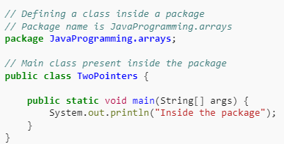
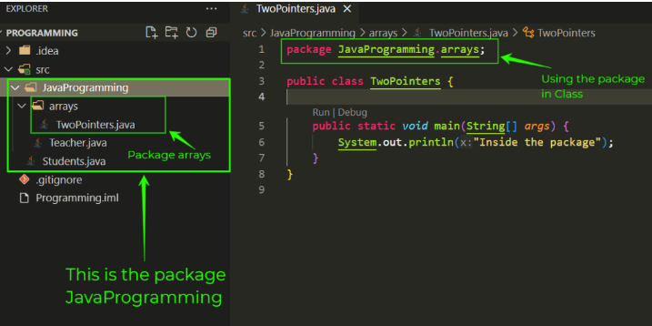
PACKAGES

Slide 29
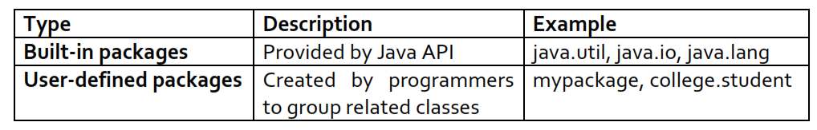
PACKAGES
Group of classes in a collection - package.
The package can then be further subdivided into subpackages.
The standard Java library is distributed over a number of packages, including java.lang, java.util, java.net, and so on.
The standard Java packages are examples of hierarchical packages.
All standard Java packages are inside the java and javax package hierarchies.
The main reason for using packages is
  To guarantee the uniqueness of class names.

Slide 30
Defining a package
To create a package …
include a package command as the first statement in a Java source file. Any classes declared within that file will belong to the specified package.
The package statement defines a name space in which classes are stored. If you omit the package statement, the class names are put into the default package, which has no name.
This is the general form of the package statement:
package packageName;

Slide 31
Java uses file system directories to store packages. More than one file can include the same package statement. The package statement simply specifies to which package the classes defined in a file belong.
You can create a hierarchy of packages. To do so, simply separate each package name from the one above it by use of a period. The general form of a multileveled package statement is shown here:
  package pkg1[.pkg2[.pkg3]];
A package hierarchy must be reflected in the file system of your Java development system.
For example, a package declared as package java.awt.image; needs to be stored in java\awt\image in a Windows environment

Slide 32
For example, the file Employee.java in
package p1;
public class Employee
{
. . .
}
If you don’t put a package statement in the source file, then the classes in that source file belong to the default package. The default package has no package name.
Place source files into a subdirectory that matches the full package name.
For example, all source files in the package p1 package should be in a subdirectory p1. The compiler places the class files into the same directory structure.
package p1.p2;
public class Employee
{
. . .
}
All source files in the package p1 package should be in a subdirectory p1/p2 on Windows.

Slide 33
The Java run-time system uses the current working directory as its starting point. Thus, our package is in a subdirectory of the current directory.
For example, the file Employee.java in
package p1;
public class Employee
{
. . .
}
If you don’t put a package statement in the source file, then the classes in that source file belong to the default package. The default package has no package name.
We can specify a directory path or paths by setting the CLASSPATH environmental variable

Slide 34
Class Importation
A class can use all classes from its own package and all public classes from other packages.
You can access the public classes in another package in two ways.
1. Simply to add the full package name in front of every class name
For example:
java.util.Date today = new java.util.Date();
This is obviously tedious.
2. Use the import statement
You can import a specific class or the whole package. You place import statements at the top of your source files (but below any package statements). For example, you can import all classes in the java.util package with the statement
import java.util.*;
Then you can use
Date today = new Date();
without a package prefix.
You can also import a specific class inside a package:
import java.util.Date;

Slide 35
import java.util.Date;
import java.io.*;
a star (*), which indicates that the Java compiler should import the entire package.
The star form may increase compilation time—especially if you import several large packages.
For this reason it is a good idea to explicitly name the classes that you want to use rather than importing whole packages.
However, the star form has absolutely no effect on the run-time performance or size of your classes.
All of the standard Java classes included with Java are stored in a package called java.
The basic language functions are stored in a package inside of the java package called java.lang.
java.lang is implicitly imported by the compiler for all programs. import java.lang.*;

Slide 36
package p1; public class Sum { int a,b; public Sum() { a=0;b=0; } public Sum(int x,int y) { a=x; b=y; } public void add() { System.out.println("sum="+(a+b)); } } | import p1.*; class Test { public static void main(String[] args) { Sum a1=new Sum(3,5); a1.add(); } }

Slide 37
package p1.p2; public class Sum { int a,b; public Sum() { a=0;b=0; } public Sum(int x,int y) { a=x; b=y; } public void add() { System.out.println("sum="+(a+b)); } } | import p1.p2.*; class Test { public static void main(String[] args) { Sum a1=new Sum(3,5); a1.add(); } }

Slide 38
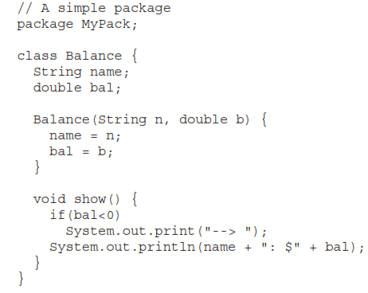

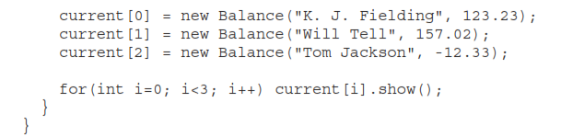
Example
AccountBalance must be qualified with its package name.
java MyPack.AccountBalance
java AccountBalance

Slide 39
INHERITANCE
Inheritance is the process of creating a class by reusing the properties of an existing class.
you can create new classes that are built on existing classes.
When you inherit from an existing class, you reuse (or inherit) its methods and you can add new methods and fields to adapt your new class to new situations.
Advantage of Inheritance:
Code Reusability

Slide 40
Classes, Superclasses, and Subclasses
Use the Java keyword extends to denote inheritance.
Existing class is called the superclass, base class, or parent class.
The new class is called the subclass, derived class, or child class.
Syntax:
class subclassname extends superclassname
{
added methods and fields
}
class Employee
{
methods and fields
}
class Manager extends Employee
{
added methods and fields
}

Slide 41
Types of Inheritance

Slide 42

SINGLE INHERITANCE
When a class extends another one class only then we call it a single inheritance.

Slide 43
//Employee class
import java.util.*;
public class Employee {
private String name;
private double salary;
void read()
{
System.out.println("enter the name");
Scanner s=new Scanner(System.in);
name=s.next();
System.out.println("enter the salary");
salary=s.nextDouble();
}
public void print()
{
System.out.println("Name: "+name);
System.out.println("Salary: "+salary);
}
public void raiseSalary(double byPercent)
{
double raise = salary * byPercent / 100;
salary += raise;
} }
//Manager class
import java.util.*;
public class Manager extends Employee
{
private double bonus;
void readManager()
{
Scanner s=new Scanner(System.in);
System.out.println("enter the bonus");
bonus=s.nextDouble();
}
public void printManager()
{
System.out.println("bonus :"+bonus);
}
}
//Main class
public class Test {
public static void main(String[] args) {
Employee e=new Employee();
e.read(); e.raiseSalary(5); e.print();
Manager m=new Manager();
m.read(); m.readManager(); m.print();
m.printManager();
} }

Slide 44
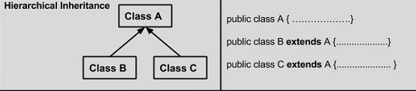
HIERARCHICAL INHERITANCE
If one class is inherited by many sub classes, then we call it as Hierarchical inheritance.

Slide 45
import java.util.*;
public class Shape
{
double height; // To hold height.
double width; //To hold width or base
public void read()
{
Scanner s=new Scanner(System.in);
System.out.println("Enter height ");
height=s.nextInt();
System.out.println("Enter width");
width=s.nextInt();
}}
public class Rectangle extends Shape
{
public double getArea()
{
return height * width;
}
}
public class Triangle extends Shape
{
public double getArea()
{
return height * width / 2;
}
}
public class Test
{
public static void main(String[] args)
{
Rectangle r = new Rectangle();
r.read();
Triangle t=new Triangle();
t.read();
System.out.println("Area of rectangle : " + r.getArea());
System.out.println("Area of triangle : " + t.getArea());
}}

Slide 46

MULTILEVEL INHERITANCE
If one class is inherited from another derived class, then we call it as Multilevel inheritance.

Slide 47
public class PERSON {
private String name;
private int age;
public void read1()
{
Scanner s=new Scanner(System.in);
System.out.println("Enter name");
name=s.next();
System.out.println("Enter age");
age=s.nextInt();
}
public void print1()
{
System.out.println("Name:"+name);
System.out.println("Age:"+age);
}
}
public class student extends PERSON{
private int rollno;
private double cgpa;
public void read2()
{
Scanner s=new Scanner(System.in);
System.out.println("Enter rollno");
rollno=s.nextInt();
System.out.println("Enter cgpa");
cgpa=s.nextDouble();
}
public void print2()
{
System.out.println("Rollno"+rollno);
System.out.println("Cgpa"+cgpa);
}
}

Slide 48
public class Employee extends student{
private int empno;
private int salary;
public void read3()
{
Scanner s=new Scanner(System.in);
System.out.println("Enter empno");
empno=s.nextInt();
System.out.println("Enter salary");
salary=s.nextInt();
}
public void print3()
{
System.out.println("Emp.No"+empno);
System.out.println("Salary"+salary);
} }
public class Test{
public static void main(String[] args) {
Employee e=new Employee();
e.read1();
e.read2();
e.read3();
e.print1();
e.print2();
e.print3();
}
}

Slide 49
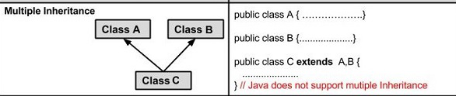
MULTIPLE INHERITANCE
If one class is derived from more than one base class, then it is multiple inheritance.
Note: Java does not support Multiple inheritance.

Slide 50
PROTECTED MEMBERS
The private members of a class cannot be directly accessed outside the class.
Only methods of that class can access the private members directly.
Sometimes it may be necessary for a subclass to access a private member of a superclass.
If you make a private member public, then anyone can access that member.
So, if a member of a superclass needs to be (directly) accessed in a subclass and yet still prevent its direct access outside the class, you must declare that member protected.

Slide 51
Access modifier
Modifier | Class | Subclass | World
public | Y | Y | Y
protected | Y | Y | N
private | Y | N | N

Slide 52
import java.util.*;
public class Shape
{
protected double height; // To hold height.
protected double width; //To hold width or base
public void read()
{
Scanner s=new Scanner(System.in);
System.out.println("Enter height ");
height=s.nextInt();
System.out.println("Enter width");
width=s.nextInt();
}}
public class Rectangle extends Shape
{
public double getArea()
{
return height * width; //accessing protected members
}
}
public class Test
{
public static void main(String[] args)
{
Rectangle rectangle = new Rectangle();
rectangle.read();
System.out.println("Area of rectangle : " +
rectangle.getArea());
}}
Output:
Enter height
3
Enter width
3
Area of rectangle : 9.0
}

Slide 53
METHOD OVERRIDING
In a class hierarchy, when a method in a subclass has the same name and type signature as a method in its superclass, then the method in the subclass is said to override the method in the superclass.
When an overridden method is called from within a subclass, it will always refer to the version of that method defined by the subclass.
The version of the method defined by the superclass will be hidden.

Slide 54
public class Base {
public void print()
{
System.out.println("Base class");
}
}
public class Derived extends Base
{
public void print()
{
System.out.println("Derived class");
}
}
public class Test{
public static void main(String[] args) {
Base b=new Base();
Derived d=new Derived();
b.print();
d.print();
}
}
output:
Base class
Derived class

Slide 55
CONSTRUCTORS IN SUBCLASSES

Slide 56
CONSTRUCTORS IN SUBCLASSES
A subclass can have its own private data members, so a subclass can also have its own constructors.
The constructors of the subclass can initialize only the instance variables of the subclass.
Thus, when a subclass object is instantiated the subclass object must also automatically execute one of the constructors of the superclass.
In Java, default constructor of base class gets automatically called when an object of the derived class is created.
if we want to call parameterized constructor of base class, then we can call it using super keyword.

Slide 57
public class Base {
Base()
{
System.out.println("Base class");
}
}
public class Derived extends Base{
Derived()
{
System.out.println("Derived class");
}
}
public class Test {
public static void main(String[] args) {
Base b=new Base();
Derived d=new Derived();
}
}
output:
Base class
Base class
Derived class

Slide 58
public class Base {
int a,b;
Base()
{
System.out.println(“BC Default cons");
a=0;
b=0;
}
Base(int x,int y)
{
System.out.println(“BC Para.. cons");
a=x;
b=y;
}
}
public class Derived extends Base{
int c,d;
Derived ()
{
System.out.println(“DC Default cons");
a=0;
b=0;
}
Derived (int x,int y)
{
System.out.println(“DC Par..cons");
c=x;
d=y;
}
}
public class JavaApplication3 {
public static void main(String[] args) {
Base b1=new Base();
Derived d1=new Derived();
Base b2=new Base(2,3);
Derived d2=new Derived(3,3);
}
}

Slide 59
output:
Base class Default constructor
Base class Default constructor
Derived class Default constructor
Base class Parameterized constructor
Base class Default constructor
Derived class Parameterized constructor

Slide 60
Super- Keyword
super has two general forms.
The first calls the superclass’ constructor.
The second is used to access a member of the superclass that has been hidden by a member of a subclass.

Slide 61
public class Base {
int a,b;
Base()
{
System.out.println(“BC Default cons");
a=0;
b=0;
}
Base(int x,int y)
{
System.out.println(“BC Para.. cons");
a=x;
b=y;
}
void print()
{
System.out.println("a="+a);
System.out.println("b="+b);
}
}
public class Derived extends Base{
int c,d;
Derived ()
{
System.out.println(“DC Default cons");
a=0;
b=0;
}
Derived (int x,int y)
{
System.out.println(“DC Param… cons");
c=x;
d=y;
}
void print()
{
System.out.println("c="+c);
System.out.println("d="+d);
}
}
public class JavaApplication3 {
public static void main(String[] args) {
Base b1=new Base();
Derived d1=new Derived();
Base b2=new Base(2,3);
Derived d2=new Derived(3,3);
d2.print();
}
}

Slide 62
output:
Base class Default constructor
Base class Default constructor
Derived class Default constructor
Base class Parameterized constructor
Base class Default constructor
Derived class Parameterized constructor
c=3
d=3

Slide 63
public class Base {
int a,b;
Base()
{
System.out.println("BC Default cons");
a=0;
b=0;
}
Base(int x,int y)
{
System.out.println("BC Para..cons");
a=x;
b=y;
}
void print()
{
System.out.println("a="+a);
System.out.println("b="+b);
}
}
public class Derived extends Base{
int c,d;
Derived ()
{
System.out.println("DC Default cons");
a=0;
b=0;
}
Derived (int a,int b,int x,int y)
{
super(a,b);
System.out.println("DC Para ..const");
c=x;
d=y;
}
void print()
{
super.print();
System.out.println("c="+c);
System.out.println("d="+d);
}
}
public class JavaApplication3 {
public static void main(String[] args) {
Base b1=new Base();
b1.print();
Derived d1=new Derived();
d1.print();
Base b2=new Base(2,3);
b2.print();
Derived d2=new Derived(2,2,3,3);
d2.print();
} }

Slide 64
output:
Base class Default constructor
a=0
b=0
Base class Default constructor
Derived class Default constructor
a=0
b=0
c=0
d=0
Base class Parameterized constructor
a=2
b=3
Base class Parameterized constructor
Derived class Parameterized constructor
a=2
b=2
c=3
d=3

Slide 65
BC Default cons
a=0
b=0
BC Default cons
DC Default cons
a=0
b=0
c=0
d=0
BC Para..cons
a=2
b=3
BC Para..cons
DC Para ..const
a=2
b=2
c=3
d=3

Slide 66

PREVENTING INHERITANCE: FINAL CLASSES AND METHODS
Final Fields:
Fields can be declared as final. A final field cannot be changed after the object has been constructed.
public class Number {
final int a=5;
public void change()
{
System.out.println("a="+a);
}
}
public class Exp1 {
public static void main(String[] args) {
Number n1=new Number();
n1.change();
}
}

Slide 67
Final Fields
public class Number {
final int a=5;
public void change()
{
a+=1;
System.out.println("a="+a);
}
}
public class JavaApplication3 {
public static void main(String[] args) {
Number n1=new Number();
n1.change();
}
}

Slide 68
Final Methods
Final Methods:
It is possible to make a specific method in a class final.
A final method cannot be overridden. Which means even though a sub class can call the final method of parent class without any issues but it cannot override it.

Slide 69
public class Base {
final void print()
{
System.out.println("Base class");
}
}
public class Derived extends Base{
void display()
{
super.print();
}
//This method definition will lead to error since print() is final in Base class
/*void print()
{
super.print();
}*/
}
public class JavaApplication3 {
public static void main(String[] args) {
Derived d=new Derived();
d.display();
}
}

Slide 70
Final Classes:
Classes that cannot be extended are called final classes, and we use the final modifier in the definition of the class to indicate this.
final public class Base {
void print()
{
System.out.println("Base class");
}
}
//trying to create a subclass from a final class leads to error
public class Derived extends Base{
}

Slide 71
Final Classes
final class Employee
{
.....
}
While creating a subclass we can also make it as final.
final class Executive extends Manager
{
. . .
}
All methods in a final class are automatically final. However, if a class is declared final, only the methods, not the fields, are automatically final.

Slide 72
FINAL CLASSES AND METHODS
Points to Remember:
A constructor cannot be declared as final.
All variables declared in an interface are by default final.
We cannot change the value of a final variable.
A final method cannot be overridden.
A final class not be inherited.

Slide 73
Object: The Cosmic Superclass
There is one special class, Object, defined by Java. All other classes are subclasses of Object.
That is, Object is a superclass of all other classes. This means that a reference variable of type Object can refer to an object of any other class.
Also, since arrays are implemented as classes, a variable of type Object can also refer to any array.
You can use a variable of type Object to refer to objects of any type:
Object obj = new Employee("Harry ", 35000);
Object is the ultimate parent class for all other classes, forming the root of the entire class hierarchy tree.

Slide 74
Object: The Cosmic Superclass
There is one special class, Object, defined by Java. All other classes are subclasses of Object.
That is, Object is a superclass of all other classes. This means that a reference variable of type Object can refer to an object of any other class.
Also, since arrays are implemented as classes, a variable of type Object can also refer to any array.
You can use a variable of type Object to refer to objects of any type:
Object obj = new Employee("Harry ", 35000);

Slide 75
Object: The Cosmic Superclass
A variable of type Object is only useful as a generic holder for arbitrary values. To do anything specific with the value, you need to have some knowledge about the original type and apply a cast:
Employee e = (Employee) obj;
In Java, only the primitive types (numbers, characters, and boolean values) are not objects.
All array types, no matter whether they are arrays of objects or arrays of primitive types, are class types that extend the Object class.
Employee[] staff = new Employee[10];
obj = staff; // OK
obj = new int[10]; // OK

Slide 76
Object: The Cosmic Superclass
public class Base {
int a;
public void read()
{
Scanner s=new Scanner(System.in);
System.out.println("Enter a");
a=s.nextInt();
}
public void print()
{
System.out.println("a="+a);
}
}
public class Test {
public static void main
(String[] args) {
Object ob=new Base();
Base b=(Base)ob;
b.read();
b.print();
}
}
Output:
Enter a 2
a=2

Slide 77
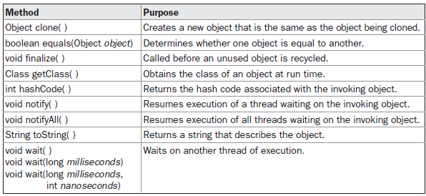
Object: The Cosmic Superclass
Object defines the following methods, which means that they are available in every object.

Slide 78
Object: The Cosmic Superclass
public class Number {
int a,b;
}
public class Test {
public static void main(String[] args) {
Number n1=new Number();
Number n2=new Number();
System.out.println("Equals method "+n1.equals(n2));
System.out.println("toString "+n1.toString());
System.out.println("hashcode "+n1.hashCode());
Class c = n1.getClass();
System.out.println("Class of Object obj is : " + c.getName());
}}
output:
Equals method false
toString Test.Number@659e0bfd
hashcode 1704856573
Class of Object obj is : Test.Number

Slide 79
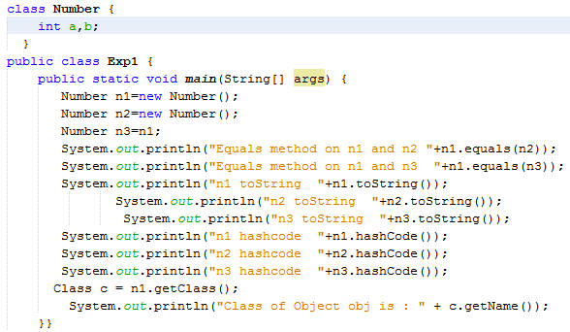
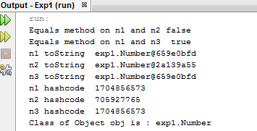
Object: The Cosmic Superclass

Slide 80
ABSTRACT CLASSES
There are situations in which you will want to define a superclass that declares the structure of a given abstraction without providing a complete implementation of every method.
That is, sometimes you will want to create a superclass that only defines a generalized form that will be shared by all of its subclasses, leaving it to each subclass to fill in the details.
Such a class determines the nature of the methods that the subclasses must implement.
An abstract class is a superclass that cannot be instantiated and is used to state or define general characteristics. Abstract class is declared with abstract keyword. It can have abstract and non-abstract methods (method with body).

Slide 81
ABSTRACT Methods
Abstract Methods:
Abstract Method is a method without method body.
It is not uncommon for a method to have no meaningful definition in the context of its superclass. To use such a method, declare it as an abstract method.
General form of an abstract method:
abstract type name(parameter-list);
No method body is present.
To declare a class abstract, you simply use the abstract keyword in front of the class keyword at the beginning of the class declaration.

Slide 82
General form of an abstract class:
abstract class classname
{
//instance variables and code
}
A class with one or more abstract methods must itself be declared abstract.
abstract class Person
{ . . .
public abstract String getDescription();
}

Slide 83
ABSTRACT CLASSES
In addition to abstract methods, abstract classes can have fields and concrete methods.
abstract class Person
{
private String name;
public abstract String getDescription();
public String getName()
{
return name;
}
}

Slide 84
ABSTRACT CLASSES
Abstract methods act as placeholders for methods that are implemented in the subclasses.
When you extend an abstract class, you have two choices.
1) You can leave some or all of the abstract methods undefined; then you must tag the subclass as abstract as well.
Here the abstract method getDescription() is not redefined. So the class Employee must also be defined abstract.
Example:
abstract Class Employee extends Person
{
public String getDescription();
//
}

Slide 85
ABSTRACT CLASSES
2) You can define all methods, and the subclass is no longer abstract.
For example, we will define a Student class that extends the abstract Person class and implements the getDescription() method. None of the methods of the Student class are abstract, so it does not need to be declared as an abstract class.
class Student extends Person
{
public String getDescription()
{
//code
}
}

Slide 86
ABSTRACT CLASSES
A class can even be declared as abstract even though it has no abstract methods.
Example:
abstract class Person
{
private String name;
public String getName()
{
return name;
}
}

Slide 87
ABSTRACT CLASSES
Abstract classes cannot be instantiated. That is, if a class is declared as abstract, no objects of that class can be created.
For example, the expression
Person p=new Person(“Abi") is an error.
However, you can create objects of concrete subclasses. Note that you can still create object variables of an abstract class, but such a variable must refer to an object of a nonabstract subclass. For example:
Person p = new Student(“Abi", "Economics");
Here p is a variable of the abstract type Person that refers to an instance of the nonabstract subclass Student.

Slide 88
abstract public class Figure {
abstract void findArea();
}
public class Rectangle extends Figure {
double a,b;
public Rectangle()
{
a=0.0d;
b=0.0d;
}
public Rectangle(double x,double y)
{
a=x;
b=y;
}
void findArea()
{
System.out.println("Area of Rectangle="+a*b);
}
}

Slide 89
public class Triangle extends Figure{
double a,b;
public Triangle()
{
a=0.0d;
b=0.0d;
}
public Triangle(double x,double y)
{
a=x;
b=y;
}
void findArea()
{
System.out.println("Area of Triangle="+0.5*a*b);
}
}

Slide 90
public class Test {
public static void main(String[] args) {
Figure f;
Rectangle r=new Rectangle(2,3);
f=r;
f.findArea();
Triangle t=new Triangle(2,3);
f=t;
f.findArea();
} }
Output:
Area of Rectangle=6.0
Area of Triangle=3.0

Slide 91
Interfaces
Interfaces are syntactically similar to classes, but they lack instance variables, and their methods are declared without any body.
Interface is a collection of abstract methods.
Once it is defined, any number of classes can implement an interface. Also, one class can implement any number of interfaces.
To implement an interface, a class must create the complete set of methods defined by the interface.
However, each class is free to determine the details of its own implementation.
By providing the interface keyword, Java allows you to fully utilize the “one interface, multiple methods” aspect of polymorphism.

Slide 92
Defining an Interface
An interface is defined much like a class.
A class describes the attributes and behaviors of an object.
An interface contains behaviors that a class implements.
interface_name is the name of the interface, and can be any valid identifier.
The methods that are declared have no bodies. They end with a semicolon after the parameter list.
General form of an interface:
Accessspecifier interface interface_name
{
return-type method-name1(parameter-list);
return-type method-name2(parameter-list);
type final-varname1 = value;
type final-varname2 = value;
// ...
return-type method-nameN(parameter-list);
type final-varnameN = value;
}

Slide 93
Defining an Interface
When no access specifier is included, then default access results, and the interface is only available to other members of the package in which it is declared.
When it is declared as public, the interface can be used by any other code. In this case, the interface must be the only public interface declared in the file, and the file must have the same name as the interface.
interface_name is the name of the interface, and can be any valid identifier.
The methods that are declared have no bodies. They end with a semicolon after the parameter list.

Slide 94
Defining an Interface
They are abstract methods; there can be no default implementation of any method specified within an interface.
Each class that includes an interface must implement all of the methods.
Variables can be declared inside of interface declarations. They are implicitly final and static, meaning they cannot be changed by the implementing class.
They must also be initialized. All methods and variables are implicitly public.
Example:
interface stack
{
int tos=-1;
void push(int x);
int pop();
}

Slide 95
Implementing Interfaces
Once an interface has been defined, one or more classes can implement that interface.
To implement an interface, include the implements clause in a class definition, and then create the methods defined by the interface.
REMEMBER When you implement an interface method, it must be declared as public.
The general form of a class that includes the implements clause looks like this:
class classname[implements interface [,interface...]]
{
// class-body
}

Slide 96
Implementing Interfaces
Example:
class StackClass implements stack
{
void push(int x)
{
//code
}
int pop()
{
//code
}
}
If a class implements more than one interface, the interfaces are separated with a comma.
class classname implements interface1,interface2,…interface n
{
//code
}

Slide 97
Implementing Interfaces
If a class implements two interfaces that declare the same method, then the same method will be used by clients of either interface.
The methods that implement an interface must be declared public. Also, the type signature of the implementing method must match exactly the type signature specified in the interface definition.
REMEMBER When you implement an interface method, it must be declared as public.
It is both permissible and common for classes that implement interfaces to define additional members of their own.

Slide 98
Accessing Implementations Through Interface References
You can declare variables as object references that use an interface rather than a class type.
Any instance of any class that implements the declared interface can be referred to by such a variable.
When you call a method through one of these references, the correct version will be called based on the actual instance of the interface being referred to.
This is one of the key features of interfaces.
The method to be executed is looked up dynamically at run time, allowing classes to be created later than the code which calls methods on them.

Slide 99
Accessing Implementations Through Interface References
The calling code can dispatch through an interface without having to know anything about the “callee.”
This process is similar to using a superclass reference to access a subclass object.
Example:
stack s;
s=new StackClass();
s.push();
s.pop();

Slide 100
Partial Implementations
If a class includes an interface but does not fully implement the methods defined by that interface, then that class must be declared as abstract.
Example:
abstract class StackClass implements stack
{
void push(int x)
{
//code
}
//pop() not defined
}

Slide 101
Nested Interfaces
An interface can be declared a member of a class or another interface. Such an interface is called a member interface or a nested interface.
A nested interface can be declared as public, private, or protected.
This differs from a top-level interface, which must either be declared as public or use the default access level, as previously described.
When a nested interface is used outside of its enclosing scope, it must be qualified by the name of the class or interface of which it is a member.
Thus, outside of the class or interface in which a nested interface is declared, its name must be fully qualified.

Slide 102
Applying Interfaces
public interface Intstack
{
void push(int item); // store an item
int pop(); // retrieve an item
void Display();
}
public class FixedStack implements Intstack
{
private int stck[];
private int tos;
// allocate and initialize stack
FixedStack(int size)
{
stck = new int[size];
tos = -1;
}

Slide 103
Applying Interfaces
// Push an item onto the stack
public void push(int item)
{
if(tos==stck.length-1) // use length member
System.out.println("Stack is full.");
else
stck[++tos] = item;
}
// Pop an item from the stack
public int pop()
{
if(tos< 0) {
System.out.println("Stack underflow.");
return 0;
}
else
return stck[tos--];
}

Slide 104
Applying Interfaces
public void Display()
{
for(int i=0;i<=tos;i++)
{
System.out.println(stck[i]);
}
}
}
public class Example
{
public static void main(String[] args)
{
int ch,choice,x;
Intstack s1;
FixedStack f=new FixedStack(5);
s1=f;
Scanner s=new Scanner(System.in);

Slide 105
Applying Interfaces
do
{
System.out.println("1.push\n2.pop\n3.Display");
System.out.println("Enter choice");
choice=s.nextInt();
switch(choice)
{
case 1:
System.out.println("Enter element to be pushed");
x=s.nextInt();
s1.push(x);
break;
case 2:
System.out.println("The popped element is"+s1.pop());
break;

Slide 106
Applying Interfaces
case 3:
System.out.println("Elements in the stack are:");
s1.Display();
}
System.out.println("Want to continue");
ch=s.nextInt();
}while(ch==1);
}
}
Output:
1.push
2.pop
3.Display
Enter choice
1
Enter element to be pushed
4
Want to continue
1

Slide 107
Applying Interfaces
1.push
2.pop
3.Display
Enter choice
1
Enter element to be pushed
6
Want to continue
1
1.push
2.pop
3.Display
Enter choice
3
Elements in the stack are:
4
6

Slide 108
Variables in Interfaces
You can use interfaces to import shared constants into multiple classes by simply declaring an interface that contains variables that are initialized to the desired values.
When you include that interface in a class (that is, when you “implement” the interface), all of those variable names will be in scope as constants.
If an interface contains no methods, then any class that includes such an interface doesn’t actually implement anything.

Slide 109
Interfaces Can Be Extended
One interface can inherit another by use of the keyword extends.
The syntax is the same as for inheriting classes.
When a class implements an interface that inherits another interface, it must provide implementations for all methods defined within the interface inheritance chain.
Example:
interface interface1 extends interface2
{
//code
}

Slide 110
Example
interface vehicleone {
int speed=90;
public void distance();
}
interface vehicletwo extends vehicleone {
int distance=100;
public void speed();
}
class Vehicle implements vehicleone, vehicletwo{
public void distance()
{
int distance=speed*100;
System.out.println("distance travelled is "+distance);
}
public void speed()
{
int speed=distance/100;
}
}

Slide 111
Example
class Test1{
public static void main(String args[]){
Vehicle obj=new Vehicle();
obj.distance();
obj.speed();
}
}
Output:
distance travelled is 9000

Slide 112


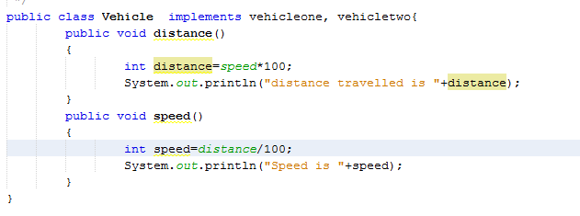
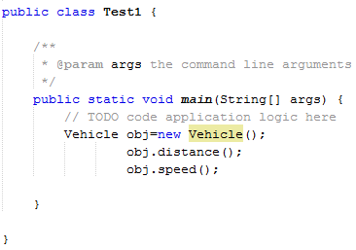
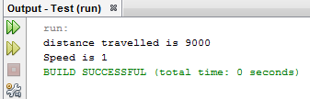
Example

Slide 113
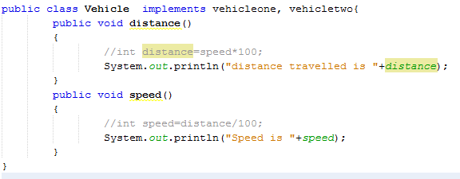
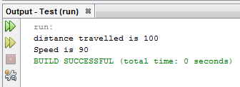
Example

Slide 114
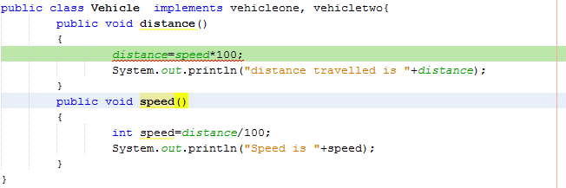
Example

Slide 115
Example program using interfaces and class
class student
{
int rollNumber;
void readNumber()
{
System.out.println("Enter Rollnumber");
Scanner s=new Scanner(System.in);
rollNumber=s.nextInt();
}
void printNumber()
{
System.out.println("Roll Number="+rollNumber);
}
}
Student

Slide 116
Example program using interfaces and class
class test extends student
{
float part1,part2;
void readMarks()
{
Scanner s=new Scanner(System.in);
System.out.println("Enter part1 marks");
part1=s.nextFloat();
System.out.println("Enter part2 marks");
part2=s.nextFloat();
}
void printMarks()
{
System.out.println("Marks Part1 "+part1);
System.out.println("Marks Part2 "+part2);
}
}
Student
test

Slide 117
Example program using interfaces and class
interface sports
{
float sportwt=6.0F;
void printSports();
}
class results extends test implements sports
{
float total;
public void printSports()
{
System.out.println("Sports Marks "+ sportwt);
}
void display()
{
total=part1+part2+sportwt;
System.out.println("Total marks of " +rollNumber+" is "+total);
}
}
Sports
Student
test
Sports
results

Slide 118
Example program using interfaces and class
class Test
{
public static void main(String srgs[])
{
results a=new results();
a.readNumber();
a.readMarks();
a.printNumber();
a.printMarks();
a.printSports();
a.display();
}
}
Output:
Enter Rollnumber
10
Enter part1 marks
50
Enter part2 marks
50
Roll Number=10
Marks Part1 50.0
Marks Part2 50.0
Sports Marks 6.0
Total marks of 10 is 106.0

Slide 119
Interfaces and class
Student
test
Sports
results

Slide 120
Multilevel inheritance
Student
test
Sports
results

Slide 121
Multiple inheritance
Student
test
Sports
results

Slide 122
Difference between abstract class and interface
Abstract class and interface both are used to achieve abstraction where we can declare the abstract methods. Abstract class and interface both can't be instantiated.
But there are many differences between abstract class and interface that are given below.
Abstract class | Interface
1) Abstract class can have abstract and non-abstract methods. | Interface can have only abstract methods. Since Java 8, it can have default and static methods also.
2) Abstract class doesn't support multiple inheritance. | Interface supports multiple inheritance.
3) Abstract class can have final, non-final, static and non-static variables. | Interface has only static and final variables.
4) Abstract class can provide the implementation of interface. | Interface can't provide the implementation of abstract class.

Slide 123
5) The abstract keyword is used to declare abstract class. | The interface keyword is used to declare interface.
6) An abstract class can extend another Java class and implement multiple Java interfaces. | An interface can extend another Java interface only.
7) An abstract class can be extended using keyword extends. | An interface can be implemented using keyword implements
8) A Java abstract class can have class members like private, protected, etc. | Members of a Java interface are public by default.
9)Example: public abstract class Shape{ public abstract void draw(); } | Example: public interface Drawable{ void draw(); }

Slide 124
Differences between classes and interfaces
Basis for Comparison | Class | Interface
Basic | A class is instantiated to create objects. | An interface can never be instantiated as the methods are unable to perform any action on invoking.
Keyword | Class | Interface
Access specifier | The members of a class can be private, public or protected. | The members of an interface are always public.
Methods | The methods of a class are defined to perform a specific action. | The methods in an interface are purely abstract.
Implement/Extend | A class can implement any number of interface and can extend only one class. | An interface can extend multiple interfaces but can not implement any interface.
Constructor | A class can have constructors to initialize the variables. | An interface can never have a constructor as there is hardly any variable to initialize.

Slide 125
Summary
Constructors in java – Types, this, finalize()
Packages
Inheritance – Super classes- sub classes –Protected members, Types, Overriding
Constructors in sub classes
the Object class
abstract classes and methods- final methods and classes
Interfaces – defining an interface, implementing interface
Differences between classes and interfaces and extending interfaces

